Slide 1



McCreary Central
2012 - 2013

Slide 2

Agenda
1. Discipline Policy Review
2. Anti-bullying
3. Internet Safety

Slide 3
Information….
Mailed Home with Registration Packets
Distributed at Registration
Discussed at Freshmen Orientation
On-line
Handout today

Slide 4
Our responsibility….
Safety
Education (Personnel, Resources, Support)
Support

Slide 5
Your responsibility….
Follow rules
Education (Attendance & Class Work)
Report

Slide 6

Dress Code
& Piercings
Attendance
& Tardies

Slide 7
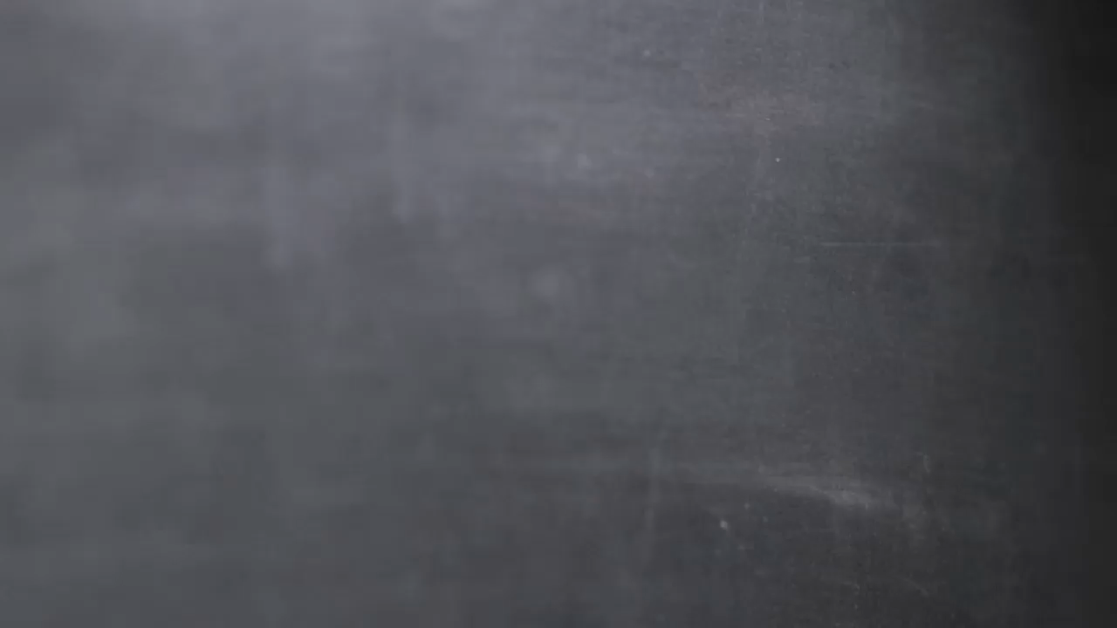
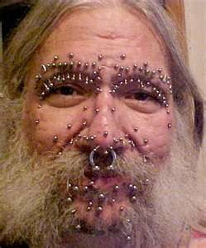
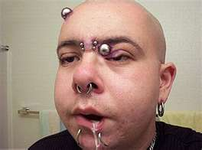
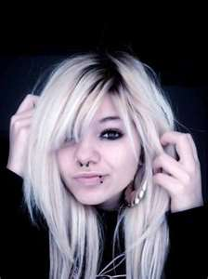
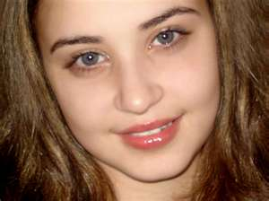
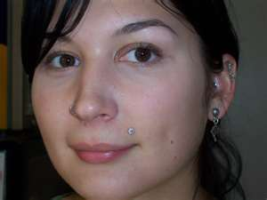
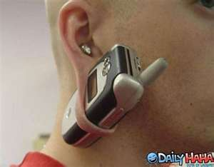
This slide contains a video animation. Play the slideshow to see the animation.
X
X
X
X
X

Slide 8
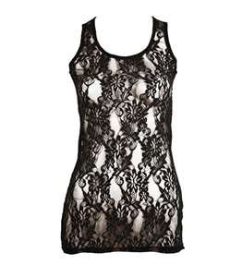



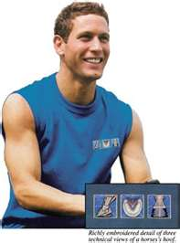
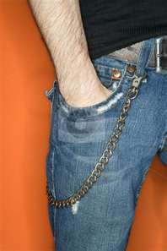
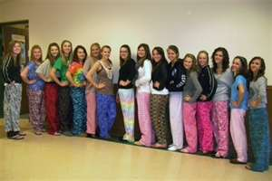

This slide contains a video animation. Play the slideshow to see the animation.

Slide 9
Cell Phones & Electronic Devices
PDA

Slide 10
Driving
& Your Parking Pass
Prom &
Trip Policies

Slide 11
Harassment, Bullying
& Fighting

Slide 12
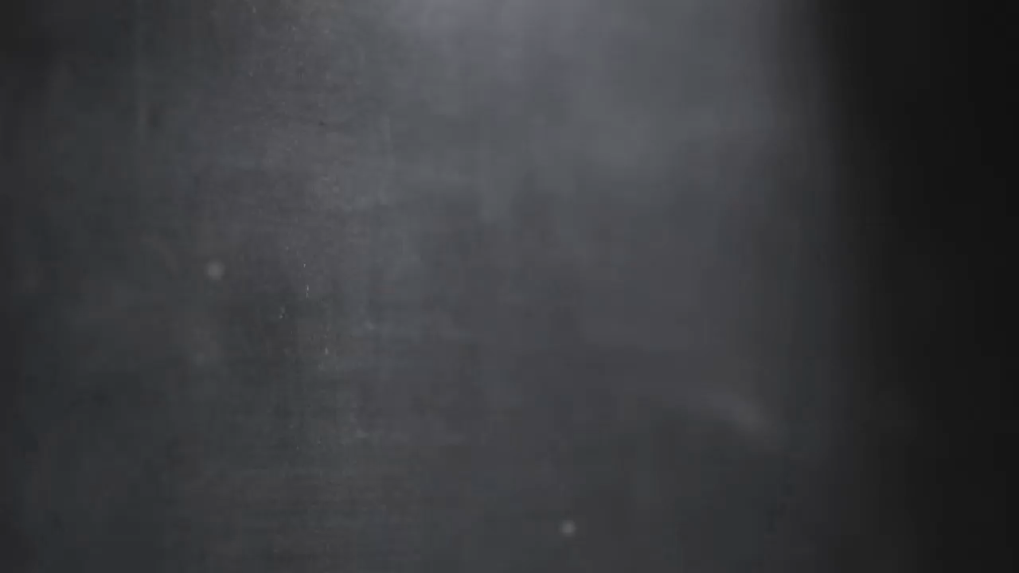
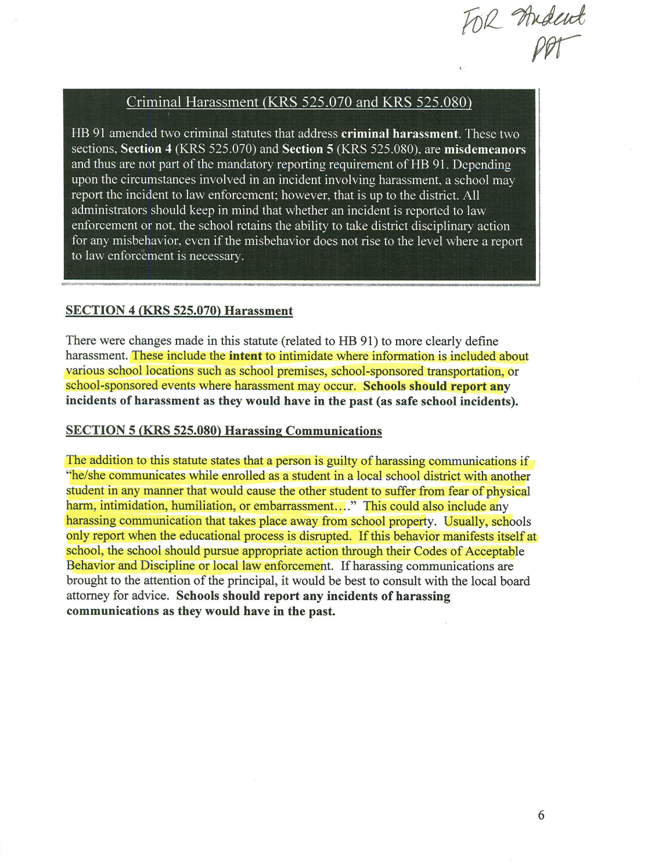
This slide contains a video animation. Play the slideshow to see the animation.

Slide 13
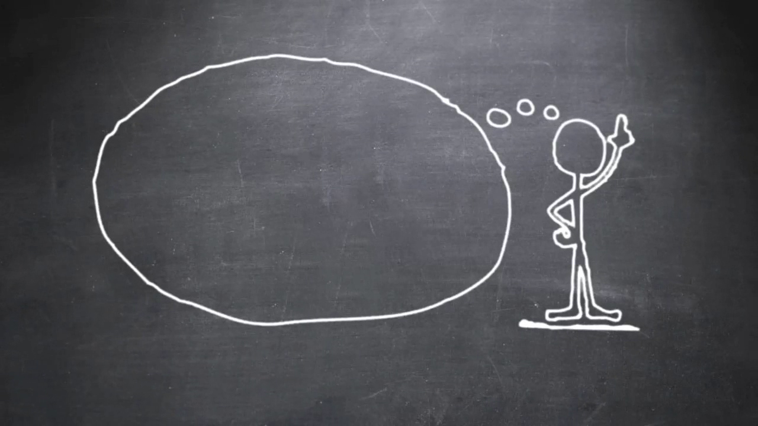
And by the way….
No pets, animals, friends, or visitors.

Slide 14
Controlled Substances
Random Drug Screening for Extra & Co-curricular Activities
Reasonable Suspicion
Tobacco Use

Slide 15
Agenda
1. Discipline Policy Review
2. Anti-bullying
3. Internet Safety

Slide 16

Bullying is…
An imbalance of power
Repeated and systematic harassment and attacks on others
Perpetrated by individuals or groups
Source: Health Resources and Services Administration National Bullying Campaign, 2004
Notes:
Emphasize that the element of bullying that makes it different from other forms of conflict is the imbalance of power. In a conflict between two individuals of equal power, each has the ability to offer solutions and compromise to resolve the conflict. In this case, adults can tell children to try to resolve the conflict on their own or to use peer mediation programs to address the issue.
In bullying situations, the imbalance of power between the bully and the victim prevents these individuals from resolving the conflict on their own. Children who are bullied need adults to step in to address the situation.

Slide 17
Bullying Can Take Many Forms
Physical violence
Verbal taunts, name-calling, and put-downs
Threats and intimidation
Extortion or stealing money and/or possessions
Spreading rumors
Harassment via technology (email, text messaging, etc.)
Source: London Family Court Clinic, London, Ontario, Canada
Notes:
Tell the participants that bullying can take many forms, as described on the slide.

Slide 18
Cyberbullying is
harassment and bullying that takes place online or through other mobile devices
Example include
Spreading rumors about someone through instant messaging
Threatening someone on a web log (blog)
Creating hurtful websites against someone

Slide 19
Cyberbullying
A Recent Survey of Teens Revealed
Cyberbullying was experienced at least one time by 43% of teens, aged 13 to 17.
Teens report that in 77% of the cases the cyberbully is someone they know.
Girls claim to have been cyberbullied more than boys – 51% to 37%.
NCPC Cyberbullying Research Report, 2006
Notes:
A survey conducted by NCPC in Feb 2006 of a nationally representative sample of 824 middle and high school students aged 13 through 17 participated in an online survey.

Slide 20
Demographic Characteristics
Children who bully
Can come from any economic, cultural, or religious background
Are often in late elementary or middle school
Notes:
Highlight the characteristics common to children and youth who are bullied. They often stand out as different in some way due to their appearance (weight, size, clothes, disability), sexual orientation, intellect, socio-economic background, or cultural or religious background.

Slide 21
Children Who Witness Bullying
When peers intervene, bullying stops within 10 seconds, 57% of the time.
Source: Hawkins, Pepler, and Craig, 2001
Notes:
Tell participants that as children and youth learn these strategies, they need the opportunity to practice them in a safe environment so they can use them when they see real bullying. Role-playing scenarios give young people the opportunity to take on different roles and practice reacting as children who are bullied or as children who witness bullying. Tell participants that you are going to demonstrate how they can use role playing with young people. Tell them that the role play that you are going to conduct comes from the lesson on bullying in Community Works, a curriculum that is part of NCPC’s teen initiative, Teens, Crime, and the Community.
Ask for four volunteers to come to the front of the room. Assign, or ask them to select, roles as the person bullying, the person being bullied, and two witnesses. Share one of the scenarios below and ask the individuals to role play this bullying situation. (Note: You may wish to institute a “no touching” rule with your participants.) Before the actors begin, read the scenario aloud to all participants.

Slide 22
Children Who Witness Bullying
Officer Neal, Mrs. Privett, Mr. Kenney, Counselor, Teacher.
Save Evidence. Share with Parents.
Notes:
Tell participants that as children and youth learn these strategies, they need the opportunity to practice them in a safe environment so they can use them when they see real bullying. Role-playing scenarios give young people the opportunity to take on different roles and practice reacting as children who are bullied or as children who witness bullying. Tell participants that you are going to demonstrate how they can use role playing with young people. Tell them that the role play that you are going to conduct comes from the lesson on bullying in Community Works, a curriculum that is part of NCPC’s teen initiative, Teens, Crime, and the Community.
Ask for four volunteers to come to the front of the room. Assign, or ask them to select, roles as the person bullying, the person being bullied, and two witnesses. Share one of the scenarios below and ask the individuals to role play this bullying situation. (Note: You may wish to institute a “no touching” rule with your participants.) Before the actors begin, read the scenario aloud to all participants.

Slide 23
Agenda
1. Discipline Policy Review
2. Anti-bullying
3. Internet Safety

Slide 24
Information….
Netsmartz
Passwords
Identity
Social Media Postings
Texting Pics & Sexting

Slide 25
Broken Friendship

Slide 26
Julie’s Journey

Slide 27
Tracking Teresa

Slide 28
You can’t take it back….

Slide 29
Your photo fate…

Slide 30
New for this year
Student Nights
Ticket Prices
$5.00 at gate
$1.00 advance at school
Free tickets for each event
Graduation, Prom, Parking Attendance Incentives

Slide 31
Looking Ahead
STEM Program
Expanded Dual Credit Options

